Slide 1
Program Design, Pseudocode, and Developing an Algorithm
Session 01
(Lecture)
Course : Program Design Methods
Effective Period : July 2018

Slide 2
These slides have been adapted from
Simple Program Design : A Step by Step Approach, Lesley Anne Robertson, Fifth Edition,
Course Technology. ISBN: 978-1-4239-0132-7. Chapter 1 - 3
Acknowledgement

Slide 3
LO 1 : Explain program design method
Learning Objectives

Slide 4
Contents
Steps in Program Development
Program Design Methodology
Procedural versus Object – Oriented Programming
An Introduction to Algorithms and Pseudocode
Program Data
How to Write Pseudocode
Meaningful Names
The Structure Theorem
Defining the Problem
Designing a Solution Algorithm
Checking the Solution Algorithm

Slide 5
Steps in Program Development

Slide 6
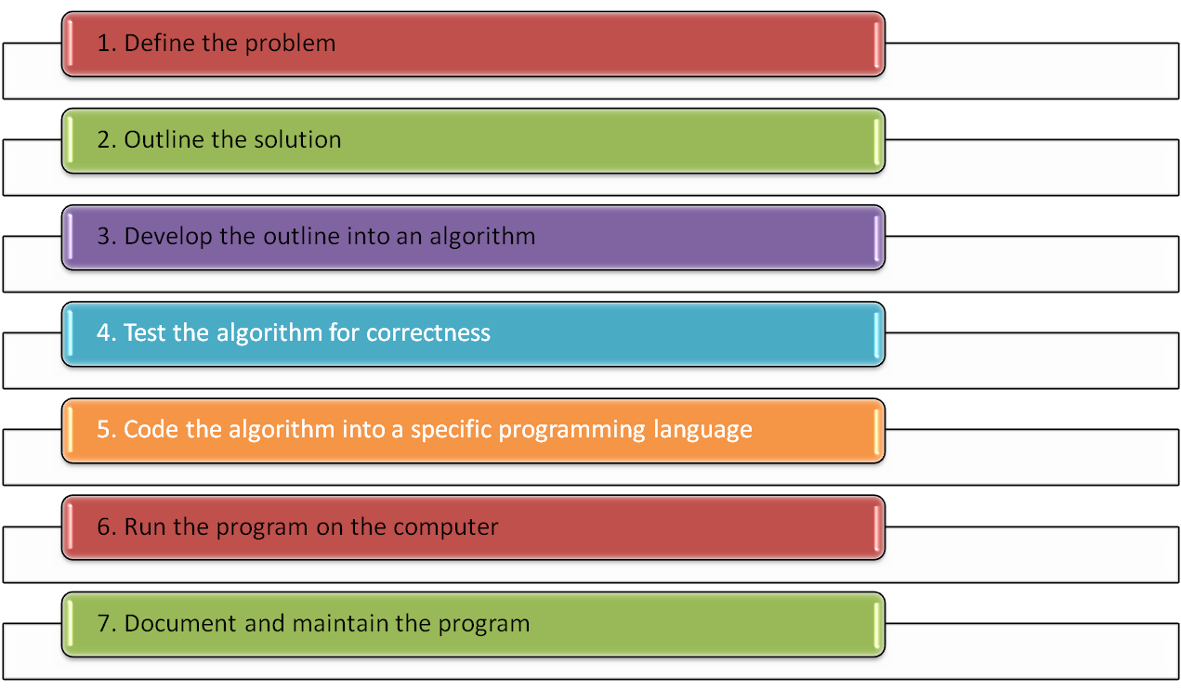
Steps in Program Development

Slide 7
Program Design Methodology

Slide 8
Program Design Methodology
The fundamental principle of program design is based on the fact that a program accepts input data, processes that data, and then delivers the data to the program user as output
The most common approaches are :
  Procedure – driven
  Event – driven
  Data – driven

Slide 9
Procedure Driven Program Design
Based on the idea that the most important feature of a program is what it does – its processes or functions
the flow of data into and out of each process or function is then considered and a strategy developed to break each function into smaller and more specific
The details about the actual structure of the data are not considered until all the high-level processes or functions of the program have been defined

Slide 10
Event Driven Program Design
Based on the idea that an event or interaction with the outside world can cause a program to change from one known state to another
The initial state of a program is identified, the all the triggers that represent valid events for that state are established
Each of these events results in the program changing to a new defined state, where it stays until the next event occurs

Slide 11
Data Driven Program Design
Based on the idea that the data in a program is more stable that the processes involved
It begins with an analysis of the data and the relationship between the data, in order to determine the fundamental data structures.
Once the data structures have been defined, the required data outputs are examined in order to establish what processes are required to convert the input data to the required output

Slide 12
Procedural vs Object Oriented Programming

Slide 13
Procedural Programming
Based on a structured, top – down approach to writing effective programs
The approach concentrate on what a program has to do and involves identifying and organizing the processes in the program solution
The problem is usually broken down into separate tasks or functions and includes top – down development and modular design

Slide 14
Object Oriented Programming
Object oriented programming is also based on breaking down the problem, but the primary focus in on the things (or objects) that make up the program
The program is concerned with how the objects behave, so it breaks the problem into a set of separate objects that perform actions and relate to each other. These objects have definite properties and each object is responsible for carrying out a series of related tasks

Slide 15
An Introduction to Algorithms and Pseudocode

Slide 16
What is an Algorithm?
The term “algorithm” is taken from the name of a mathematician named Al-Khwarizmi
Algorithm consist of needed steps to accomplish a task
The algorithm is written in simple English and is not a formal document.
An algorithm must :
  Be lucid, precise and unambiguous
  Give the correct solution in all cases
  Eventually end

Slide 17
Example of an Algorithm
Example: instruct someone to add up a list of prices on a pocket calculator
turn on calculator
clear calculator
repeat the following instructions
key in dollar amount
key in decimal point (.)
key in cents amount
press addition (+) key
until all prices have been entered
write down total price
turn off calculator

Slide 18
What is Pseudocode ?
Pseudocode is used to represent the algorithm
The common characteristics of pseudocode :
  Statements are written in simple English
  Each instructions is written on a separate line
  Keywords and indentation are used to signify particular control structures
  Each set of instructions is written from top to bottom, with only one entry and one exit
  Groups of statements may be formed into modules, and the module given a name

Slide 19
Program Data

Slide 20
Variables, Constants and Literals
Variable :
  A collection of memory cells designed to store a particular data item
  It is called a variable because the value stroed in those memory cells may change pr vary as program executes
Constant :
  A data item with a name and a value that remain the same during the execution of the program
Literal :
  A constant whose name is the written representations of its value

Slide 21
Data Types
Data Types :
  Elementary Data Items :
    Integer
    Real
    Character
    Boolean
  Data Structures
    Record
    File
    Array
    String

Slide 22
How to Write Pseudocode

Slide 23
Six Basic Computer Operations
A computer can receive information
A computer can put out information
A computer can perform arithmetic
A computer can assign a value to a variable or memory location
A computer can compare two variables and select one of two alternative actions
A computer can repeat a group of actions

Slide 24
Meaningful Name

Slide 25
Meaningful Name
When designing a solution algorithm, a programmer must introduce some unique name, which will be used to represent the variables or objects in the problem. The name itself should be transparent enough to adequate describe the variable
All names should be meaningful

Slide 26
The Structure Theorem

Slide 27
The Structure Theorem
The structure theorem states that it is possible to write any computer program using only three control structure :
  Sequence : is the straightforward execution of one processing step after another
  Selection : is the presentation of a condition and the choice between two actions, the choice depending on whether the condition is true or false
  Repetition : is the presentation of a set of instructions to be performed repeatedly.

Slide 28
Developing an Algorithm

Slide 29
Defining the Problem
Defining the problem involves carefully reading and rereading the problem until understand completely what is required
To help with this initial analysis, the problem should be divided into three separate components
  Input : a list of the source data provided to the problem
  Output : a list of the outputs required
  Processing : a list of actions needed to produce the required outputs

Slide 30
Designing a Solution Algorithm
Once the problem has been properly defined, the next step will be outline the solution
Pseudocode is useful present the solution algorithm

Slide 31
Checking the Solution Algorithm
After a solution algorithm has been established, it must be tested for correctness
Desk checking involves tracing through the logic of the algorithm with some chosen test data. That is, “walk” through the logic of the algorithm exactly as a computer would, keeping track of all major variable values on a sheet of paper

Slide 32
Checking the Solution Algorithm
There are six simple steps to follow when desk checking an algorithm:
  Choose simple input test cases that are valid. Two or three test cases are usually sufficient
  Establish what the expected result should be for each test case
  Make a table on a piece of paper of the relevant variable names within the algorithm
  Walk the first test case through the algorithm, line by line, keeping a step – by – step record of the contents of each variable in the table as the data passes through the logic
  Repeat the walk-through process using the other test data cases, until the algorithm has reached its logical end
  Check that the expected result established in step 2 matches the actual result developed in step 5

Slide 33
References
Simple Program Design : A Step by Step Approach., Lesley Anne Robertson, Fifth Edition,
Course Technology. ISBN: 978-1-4239-0132-7.
The Structured Theorem, http://www.docstoc.com/docs/4530185/Developing-an-Algorithm-The-Structure-Theorem-The-Structured-Theorem
Vague Pseudocode Examples, http://users.csc.calpoly.edu/~jdalbey/SWE/pdl_vague.html ‎
Object Oriented Overview, http://www.tutorialspoint.com/uml/uml_quick_guide.htm/SWE/pdl_vague.html

Slide 34
Q & A

